Slide 1
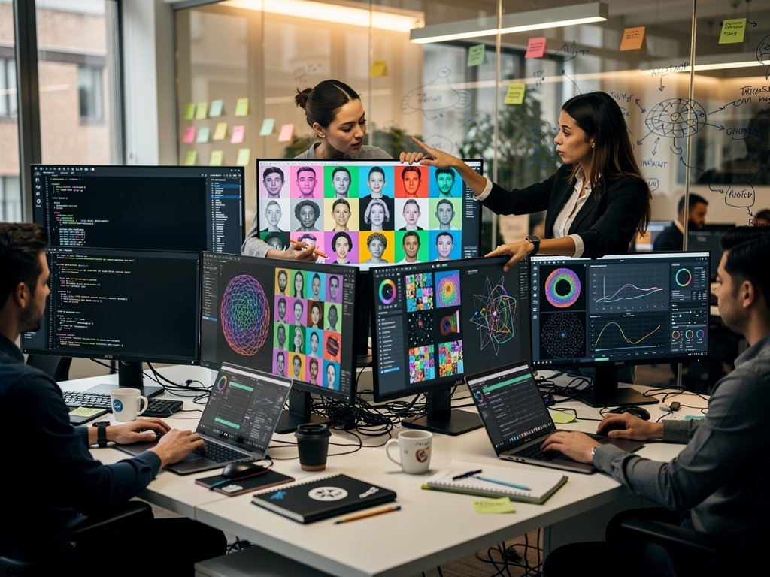
Generative Artificial Intelligence Part 2
DALL-E3 Prompt: Data Scientists celebrate a generative ai Halloween
Notes:
DALL-E Prompt: A group of data scientists using AI to generate images

Slide 2
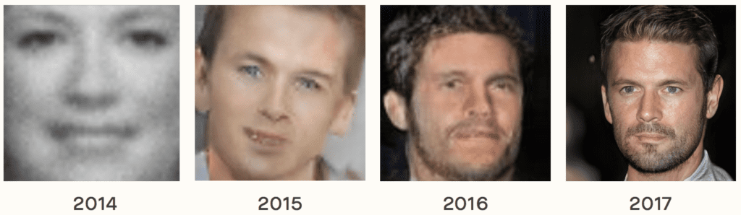
Where we’re going: image generation!

Slide 3
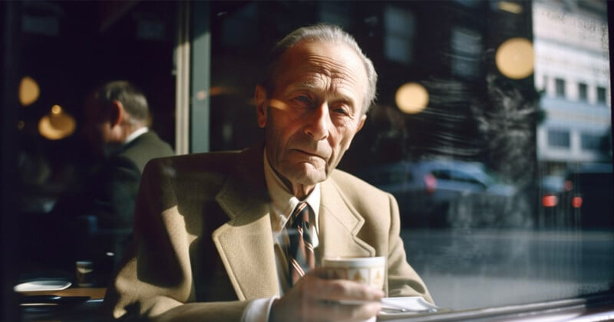

Slide 4


Slide 5

Specifically: conditional image generation
A photo of a Corgi dog riding a bike in Times Square. It is wearing sunglasses and a beach hat.

Slide 6
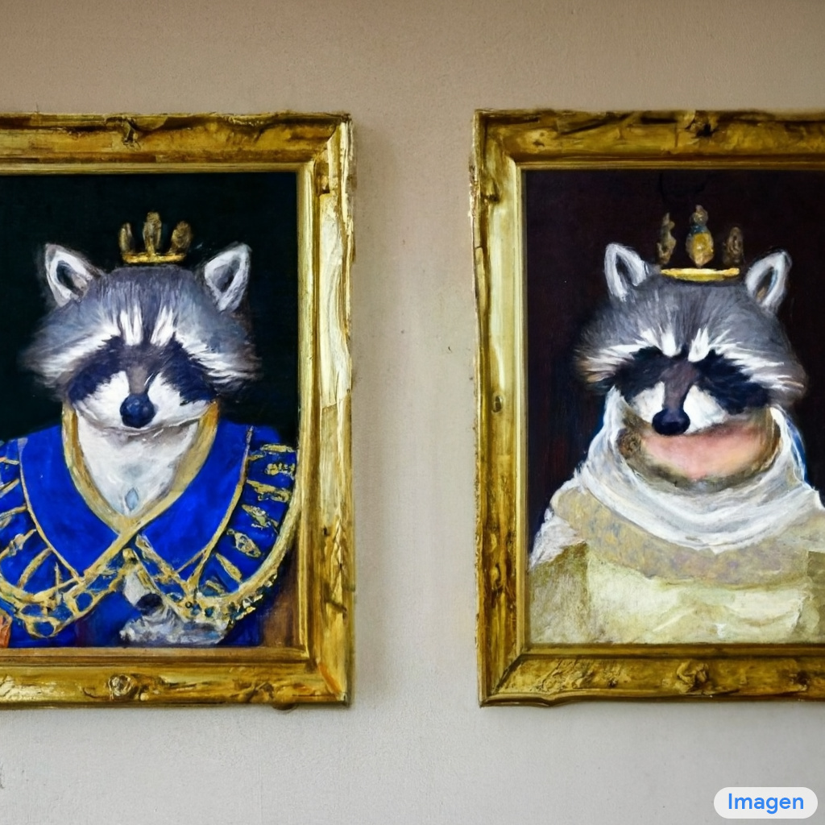
Specifically: conditional image generation
A wall in a royal castle. There are two paintings on the wall. The one on the left a detailed oil painting of the royal raccoon king. The one on the right a detailed oil painting of the royal raccoon queen.

Slide 7

Specifically: conditional image generation
A detailed and tightly rendered cyberpunk oil painting of a modified (cyberpunk) orange and black (mechanical hybrid design of a Porsche 911 GT3 R merged with a 2014 Nissan Xterra) in a rugged cross country race :: (entire vehicle) :: racing tires :: flourescent colored paint :: modified (very high-tech), cg, concept art, bright colored paint, artstation, art, cyberpunk, octane render, by Matthew Abram Groening,

Slide 8
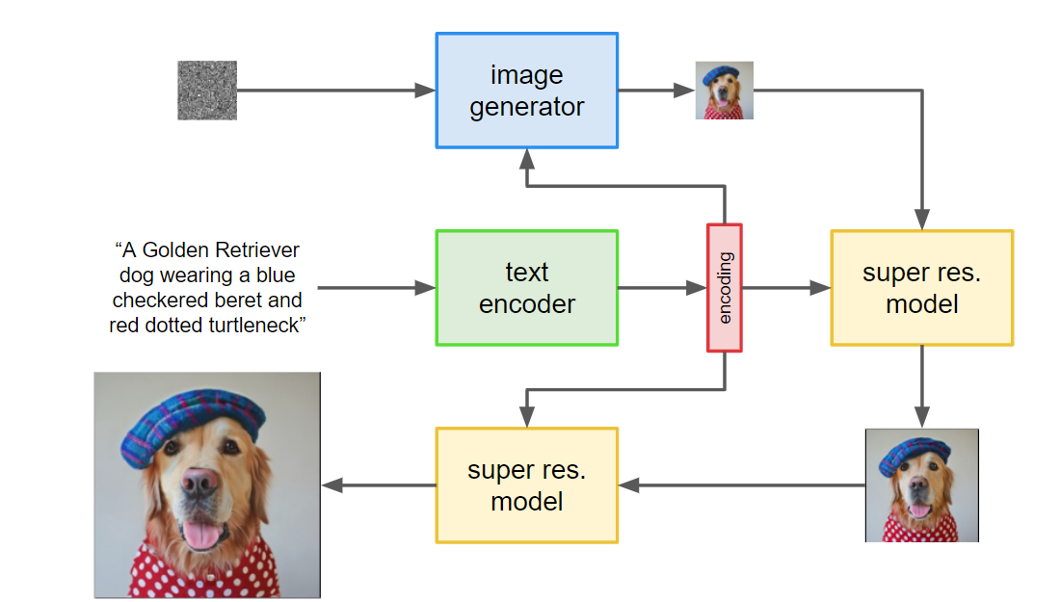

Slide 9
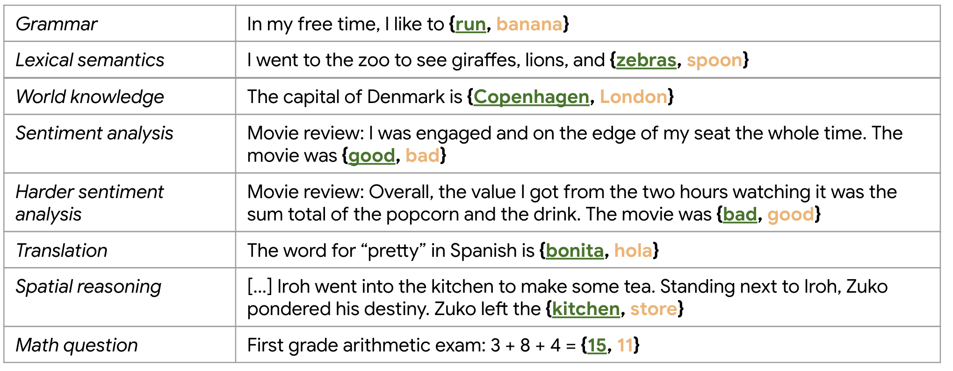
What do models learn from next-word prediction?

Slide 10
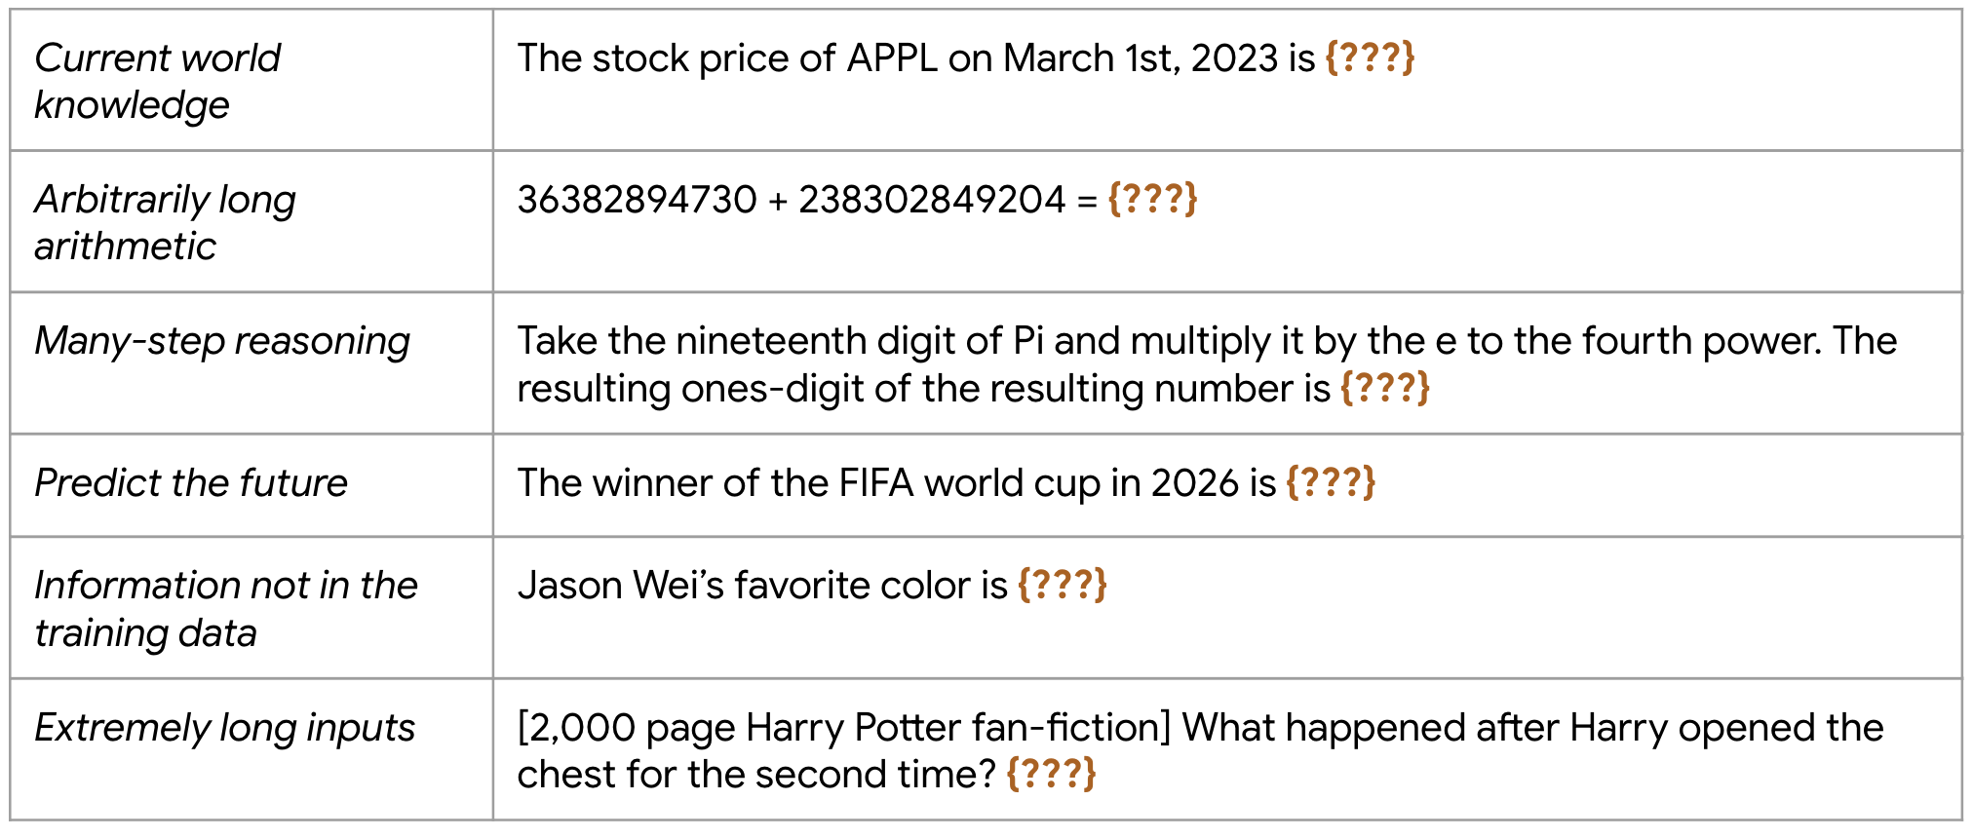
What can’t they learn from next-word prediction?

Slide 11
Algorithmic bias and toxicity
Models / algorithms aren’t biased, but training data is
Negative biases can be reflected (and amplified!) in outputs
Many different types of toxicity and bias
Sexism (eg, gendered professions)
Racism
Negative stereotypes (eg, black criminality)
Sexual orientation
Ableist, anti-Muslim, profane, lewd, violent, seditious…
Liberal, rich, educated…
“Feeding AI systems on the world’s beauty, ugliness, and cruelty, but expecting it to reflect only the beauty is a fantasy.”
-- Ruha Benjamin

Slide 12
Case study #1: analyzing autism interviews

Slide 13
Goal: study early indicators of autism
Data: transcripts of 18 interviews with parents of autistic daughters
Wide ranging topics. Nuanced statements. Implicit contexts.
Central question: are there patterns in the data?
Standard methodology: human coding of the data (via CQR, etc.)
Slow – 6 months!
AI methodology: combination of language models and embeddings

Slide 14
How to analyze unstructured text?
..[Daughter] is very quiet and obedient, and she doesn’t get a lot of attention in a group setting, and I think she got overlooked. So, when she went to first grade, and she had to have an aide they would take her to the back of the room and work with her on her alphabet things and so, she was a little bit behind in first grade, she had to catch up in maybe half of first grade, but she learned to read just fine and once she read, she was very good at it. She is an excellent reader, of course this is one of my kids I read to voraciously, and she got read to as a baby and a child a lot, so maybe that helped, I don’t know, but she is a good reader, good reading comprehension. She doesn’t struggle with that at all and didn’t ever. I mean, once she got into probably fifth or sixth grade, I had nothing to do with her academic, she just ran her own life and did everything and did really well.
Notes:
How would you analyze this?
It’s hard to see how standard ML tools can help… clustering, regression, neural networks…
Maybe structured topic models. TBH, I don’t think it works very well.

Slide 15
Use Llm to extract concrete observations
..[Daughter] is very quiet and obedient, and she doesn’t get a lot of attention in a group setting, and I think she got overlooked. So, when she went to first grade, and she had to have an aide they would take her to the back of the room and work with her on her alphabet things and so, she was a little bit behind in first grade, she had to catch up in maybe half of first grade, but she learned to read just fine and once she read, she was very good at it. She is an excellent reader, of course this is one of my kids I read to voraciously, and she got read to as a baby and a child a lot, so maybe that helped, I don’t know, but she is a good reader, good reading comprehension. She doesn’t struggle with that at all and didn’t ever. I mean, once she got into probably fifth or sixth grade, I had nothing to do with her academic, she just ran her own life and did everything and did really well.
What prompt would you use to extract this information?

Slide 16
Here is the Prompt that the researchers used:
The following paragraphs were taken from interviews with parents of autistic daughters. Examine the paragraphs and summarize any concrete observations that the parent made about the child. List each observation on a separate line. If the paragraph doesn't contain a concrete observation, or is "small talk", then respond with "none". Be as specific as possible. Do not use general phrases like "Autistic Challenges" or "Parental Observations". Analyze the paragraphs and summarize concrete observations, or say "none":
Paragraph: Okay, well don’t share it with the world, okay? I am not a Facebook person.
Concrete observation: none
Paragraph: but she, she’s a real talker, I mean, she loves to talk and a very social person and… once she learned she was, oh, always opens her mouth. I mean, if she’s autistic, she’s not wrapped up in herself. She’s you know, looking to other people to associate with them, and socialize. She, she loves people. But—
Concrete observation: loves to talk
Concrete observation: is a very social person
Concrete observation: is not wrapped up in herself
Concrete observation: looks to other people to associate with them
Concrete observation: loves people
Paragraph: But coordination has been, you know, she’s lacked coordination, you know like sports, and things like that, large motor skills, yeah.
Concrete observation:

Slide 17
Works surprisingly well!
2,535 observations
Nicely tagged with interview, paragraph #
… but now what?
We’d really like to somehow cluster these…
,filename,paragraph_number,concrete_observation
0,interview222-282.json,2,had the cord wrapped around her neck at birth
1,interview222-282.json,2,was slower learning to talk
2,interview222-282.json,2,was slower learning to walk
3,interview222-282.json,3,didn't crawl as a baby
4,interview222-282.json,3,walked without crawling first
5,interview222-282.json,3,resisted attempts to learn how to crawl
6,interview222-282.json,3,was taken to a facility for children not developing properly
7,interview222-282.json,4,attended speech therapy
8,interview222-282.json,4,doesn't stop talking
9,interview222-282.json,5,loves to talk
10,interview222-282.json,5,is a very social person
11,interview222-282.json,5,is not wrapped up in herself
12,interview222-282.json,5,looks to other people to associate with them
13,interview222-282.json,5,loves people
14,interview222-282.json,7,started walking at fourteen months
15,interview222-282.json,7,fine motor skills were slower to develop
16,interview222-282.json,7,taught herself how to play the piano
17,interview222-282.json,8,is a very fast typist
18,interview222-282.json,9,lacks coordination
...

Slide 18
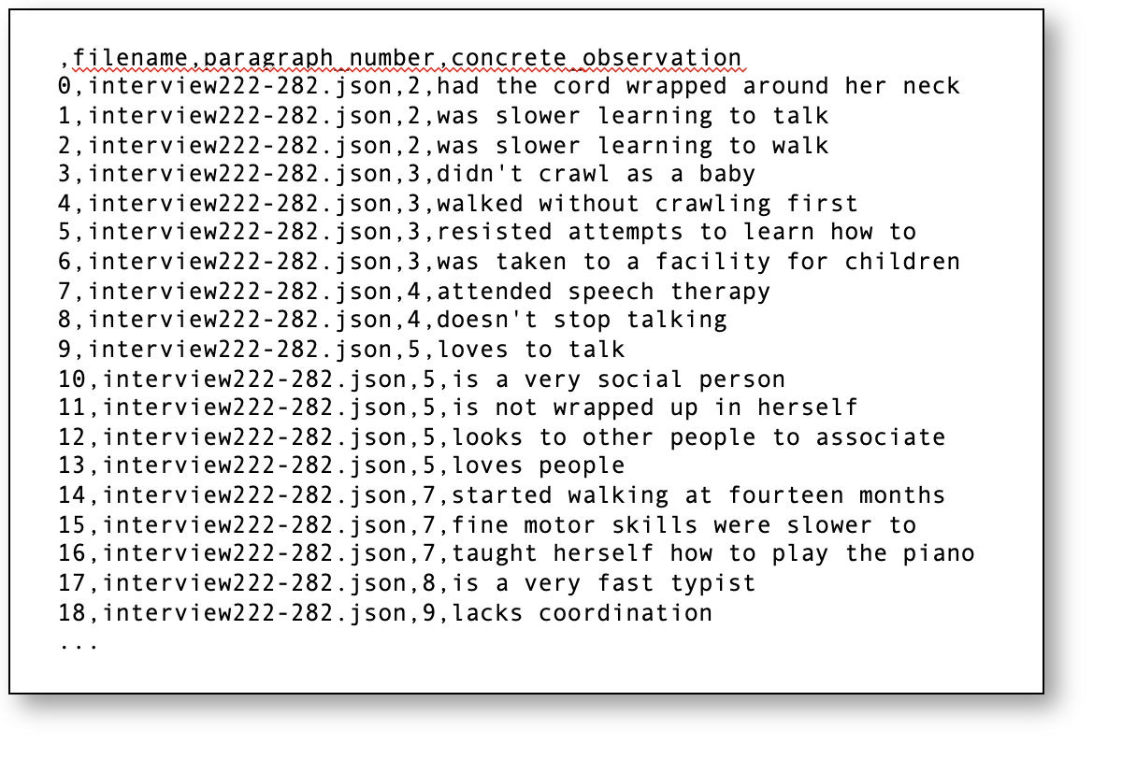
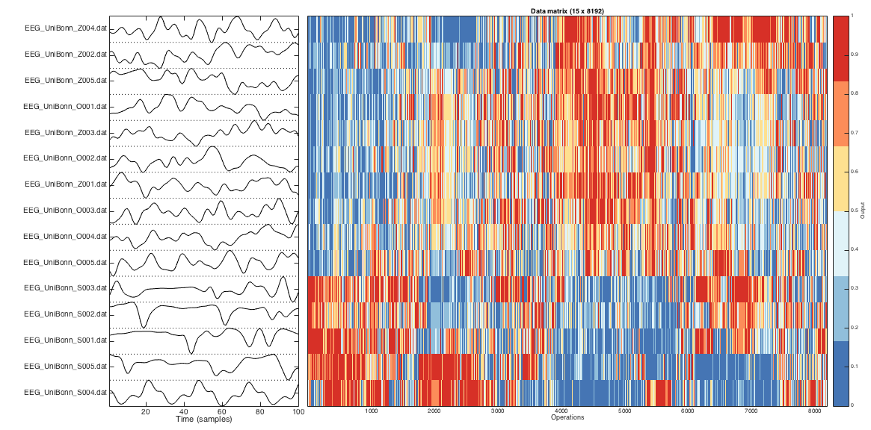
Run each observation through an embedder

Slide 19
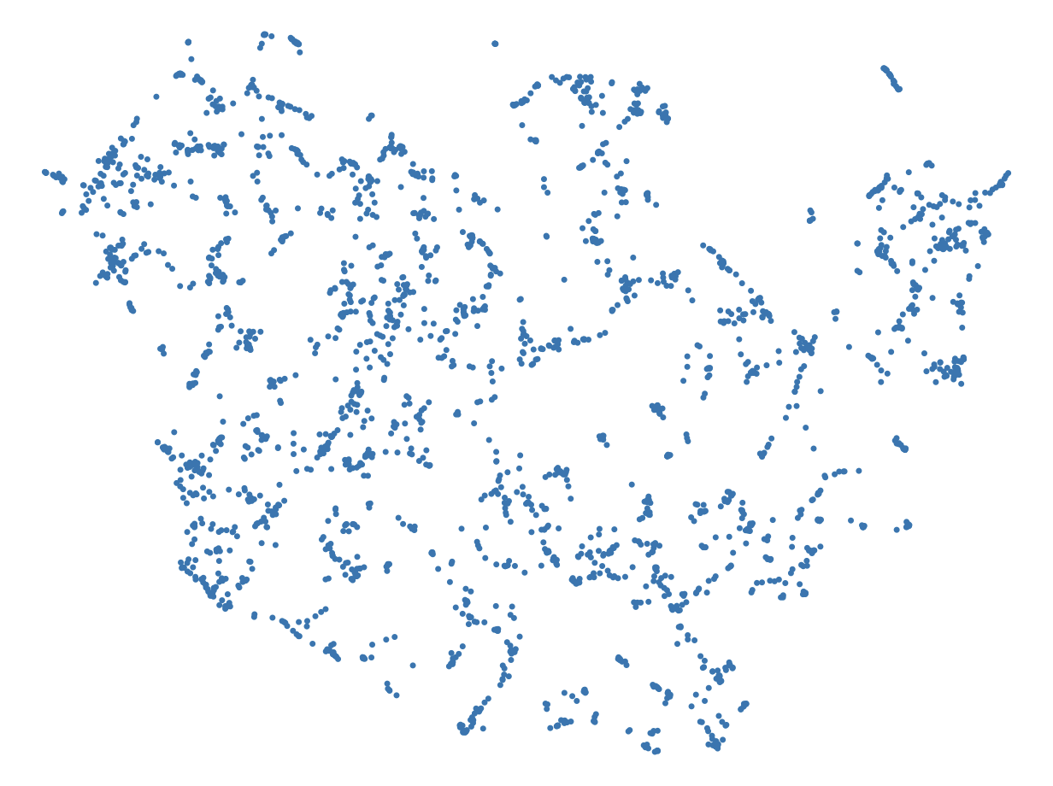
The embedded observations can be visualized…
Started talking early on
Had a good grasp of conversations
Speaking ability was above average
Sensitive to light and sounds
No-nonsense personality
Sensitive to sunlight
Is very rigid
Is sensitive to certain touches
Is very serious and stoic

Slide 20
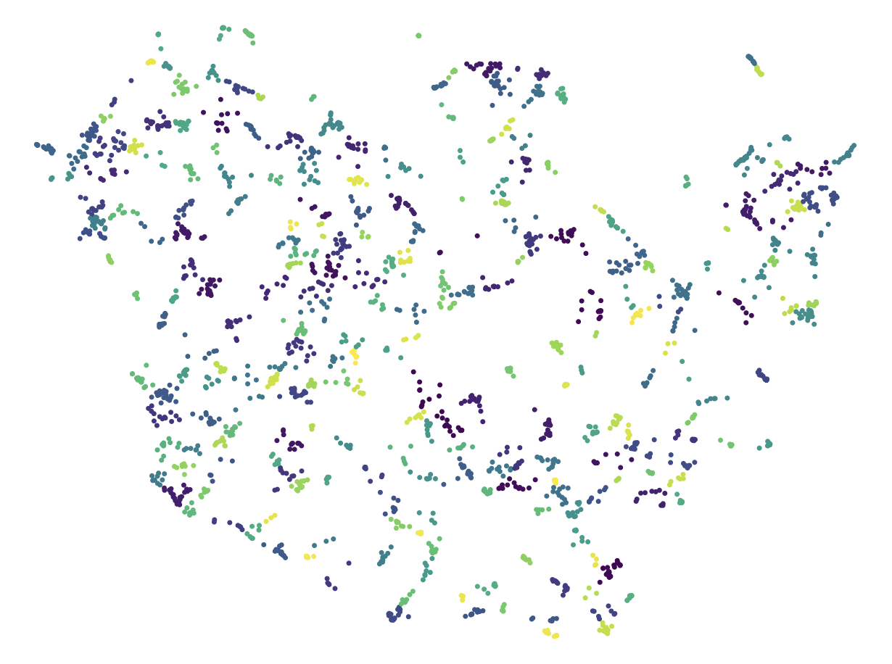
…And clustered!

Slide 21
Results!
Cluster 11: Social Ineptitude Despite Intellectual Capacity
missing out on some social things because she doesn’t fully engage in it
often didn't know what was happening in her social circle
feels defensive when with people who are not her friends
didn't learn or practice social skills in her early teens
social understanding has not tracked with her academic progress
disconnect between her intellect and social application
daughter doesn't like to initiate social interactions
teachers initially didn't recognize her intelligence
felt she was really stupid, despite being smart

Slide 22
Results!
Cluster 122: Rapid Learning Ability
is a very fast typist
caught onto reading well
joined the top reading group within two months of changing schools
is a fast reader
is a very fast reader
could read very fast
picked up reading easily
read very quickly
picked up reading very fast
never had trouble comprehending things according to report cards
never expressed trouble comprehending things

Slide 23
Results!
Cluster 77: Sensory Overstimulation
has a hard time with clutter
views disorganized spaces as a nightmare
wears headphones to block out noise
is bothered by noise
has a hard time dealing with sounds like chewing or breathing
struggles with repetitive types of sound
is bothered by too much noise
is bothered by too many lights
is bothered by too much talking
disturbed by sounds and lights in the grocery store
can hear electric lights

Slide 24
Case study #2: depolarizing chatbot

Slide 25
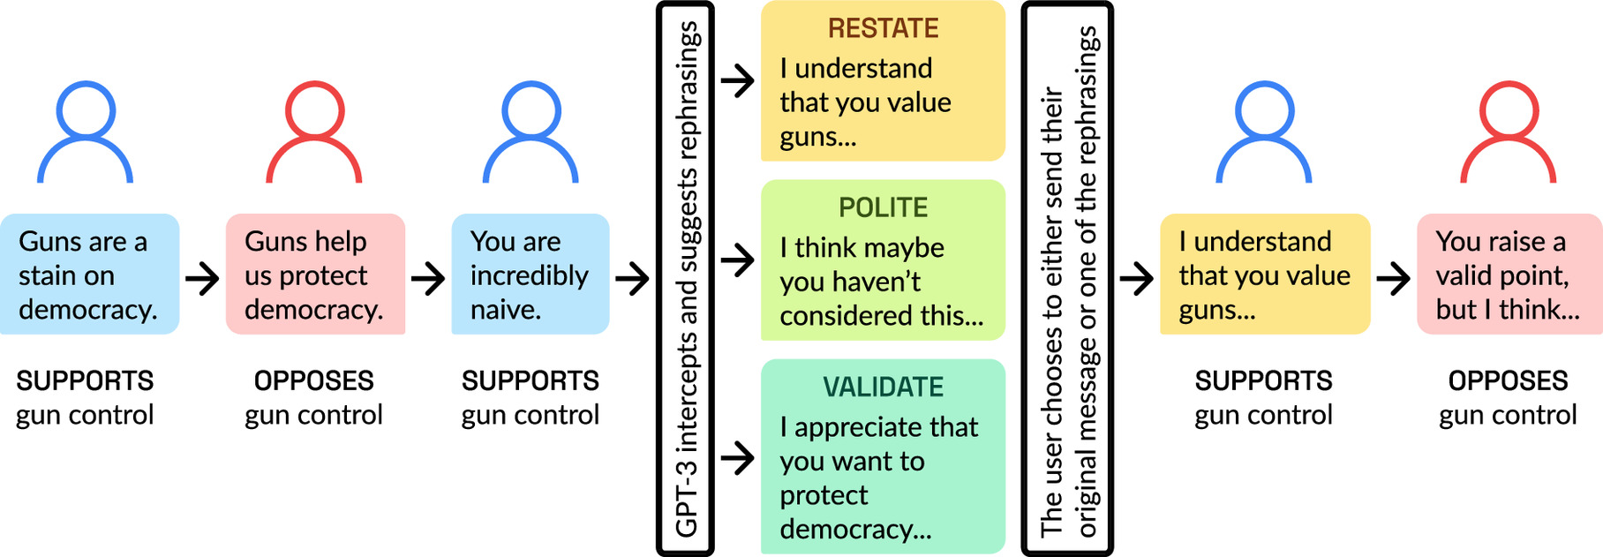
Can we improve Civil conversation between hotly opposing views?
Idea: Recruit opposing partisans and have them talk about hot-button issues. What could possibly go wrong?
Wingate et al, PNAS, 2023

Slide 26
Prompt:
You will see conversations between two people who disagree about gun control.
Given the conversation, rephrase so that it is polite and non-defensive.
Also, if the language is very strong, try to soften the tone of the message.
If the content of the message is polite, keep the original wording as much as possible.
Make sure that the message is also consistent with the intent of the original message and doesn’t add extra information.
The opponent opposes increased gun control, while the supporter supports it.
<INSERT CONVERSATION w/MESSAGE TO BE REPHRASED>

Slide 27
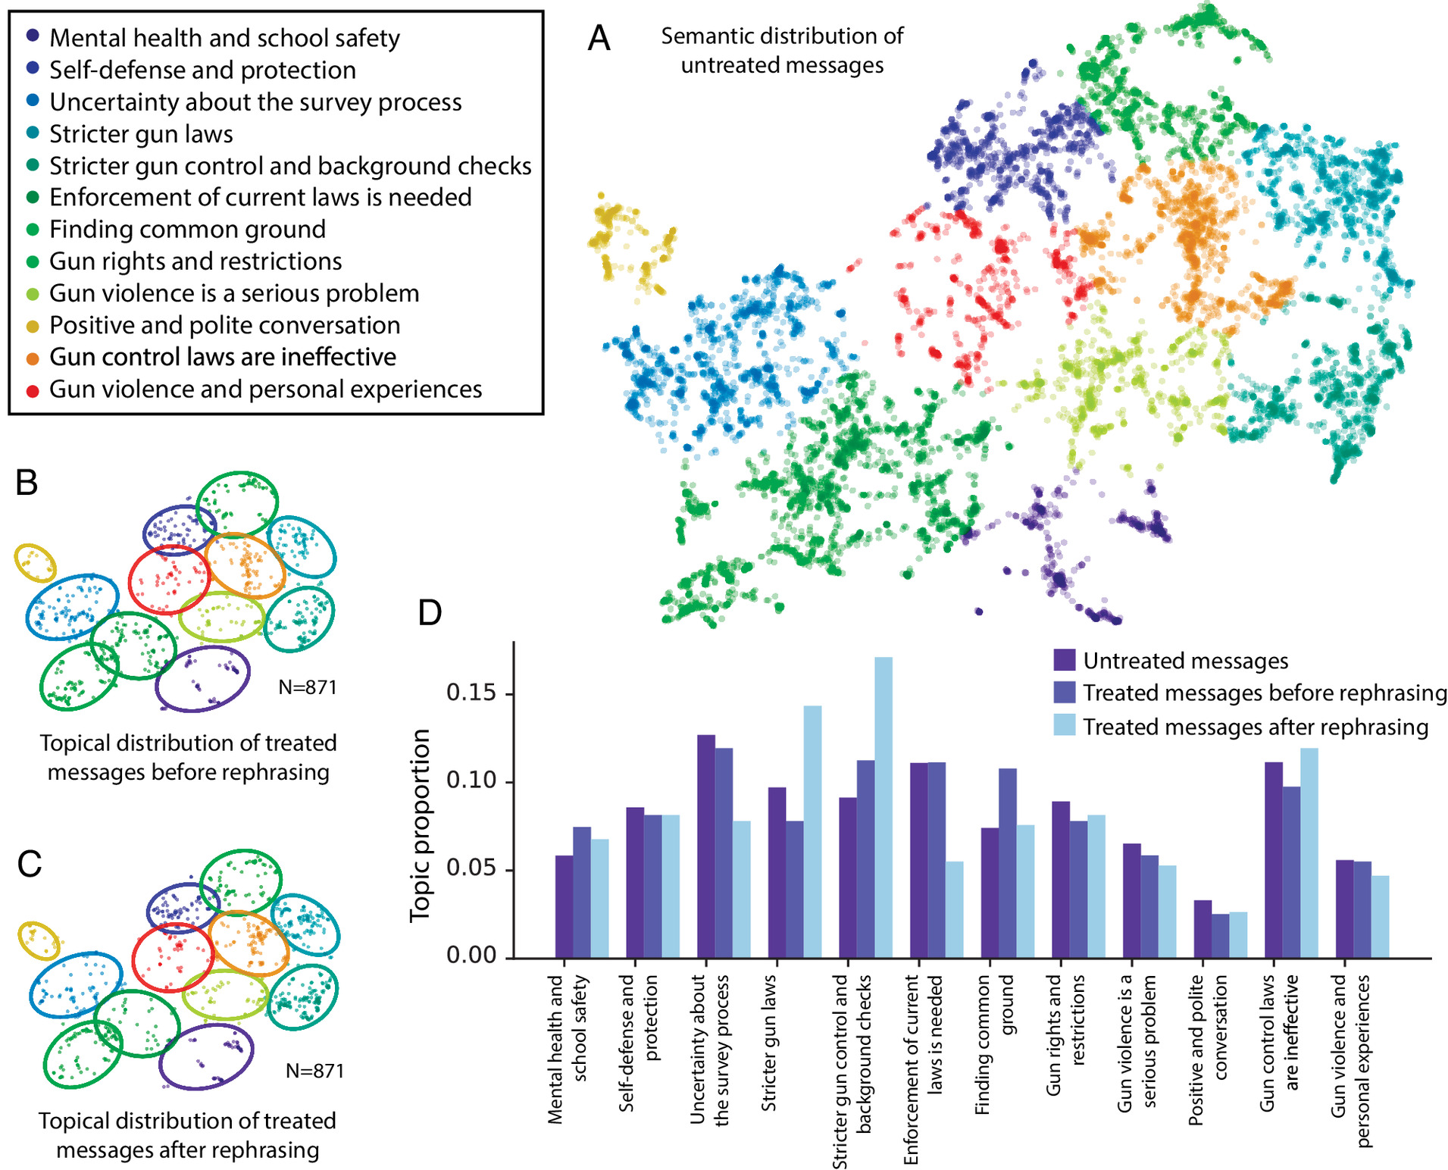

Slide 28
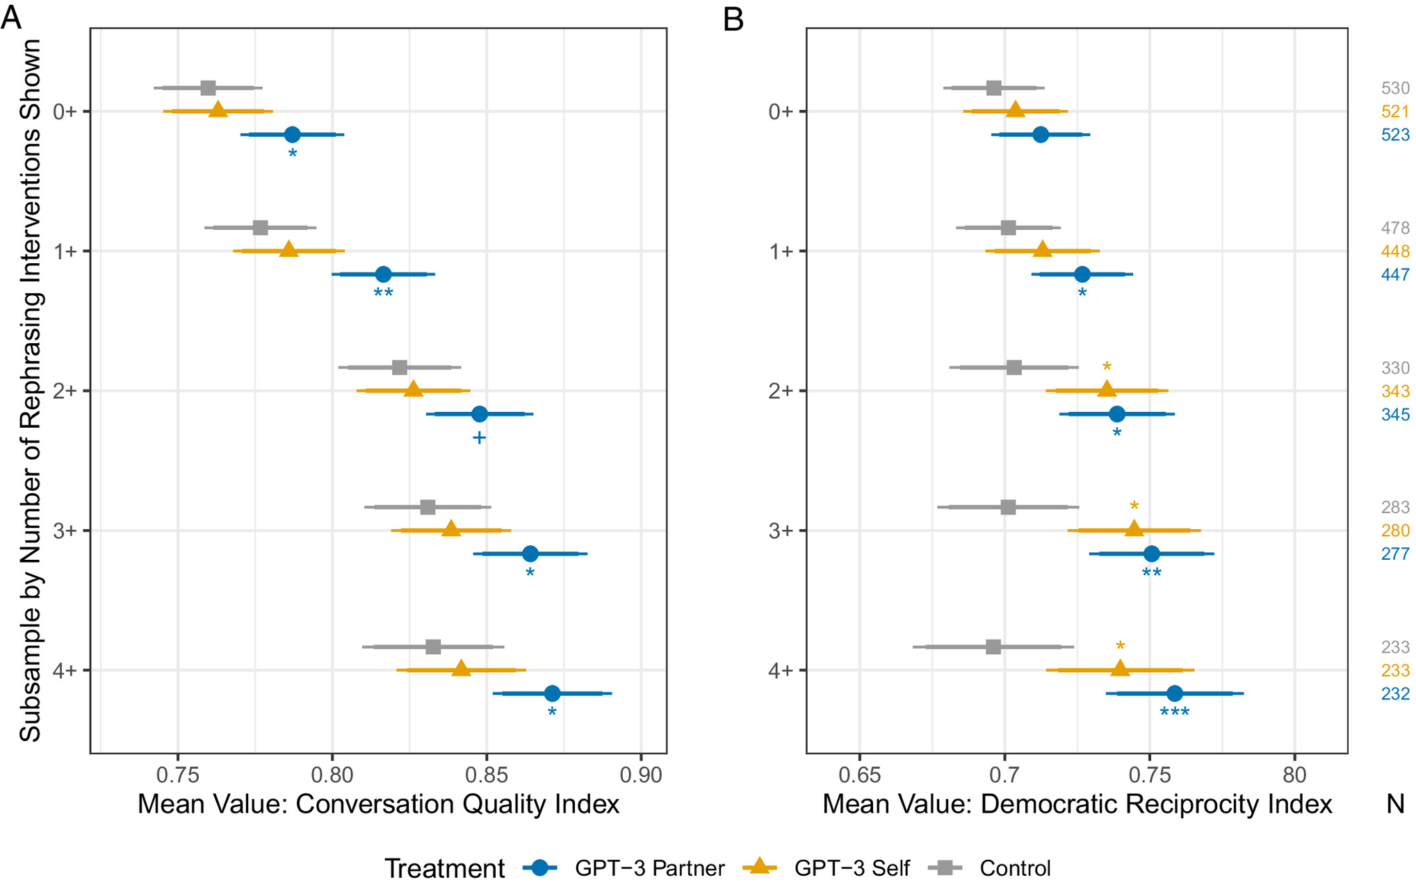

Slide 29

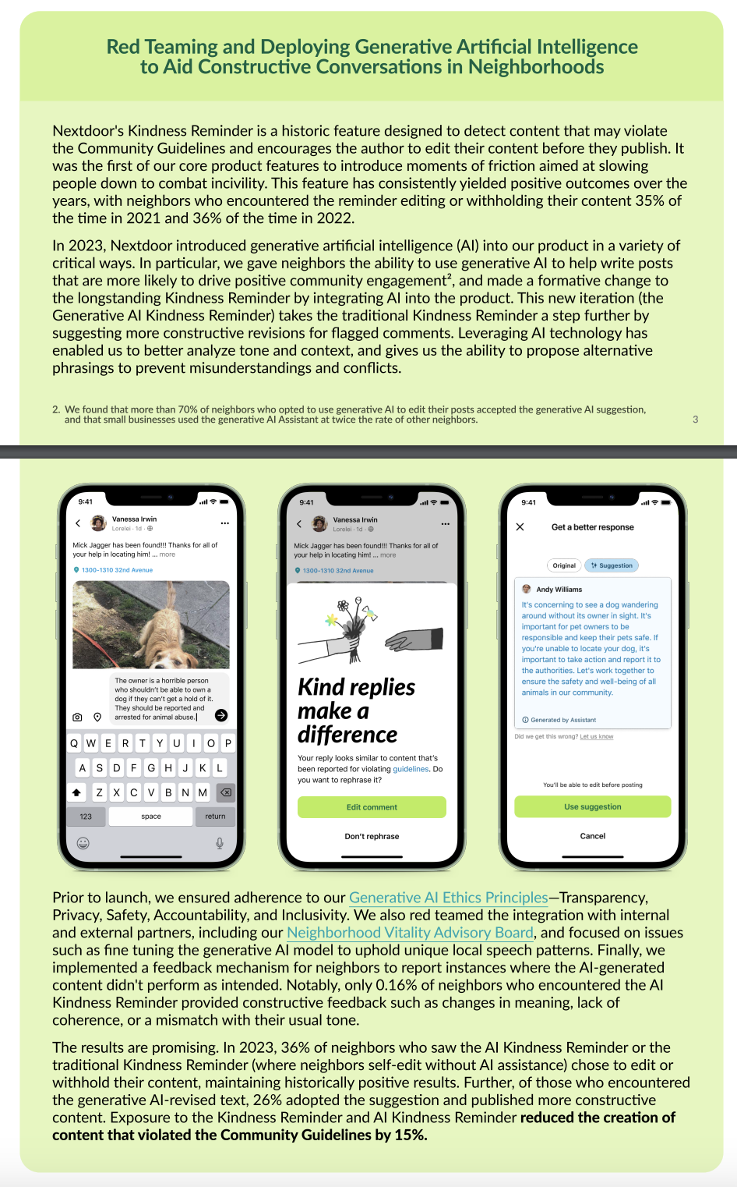
Source: NextDoor Transparency Report, 2023
Notes:
https://about.nextdoor.com/wp-content/uploads/2024/02/Nextdoor-Transparency-Report-2024-2023-Reflection.pdf

Slide 30
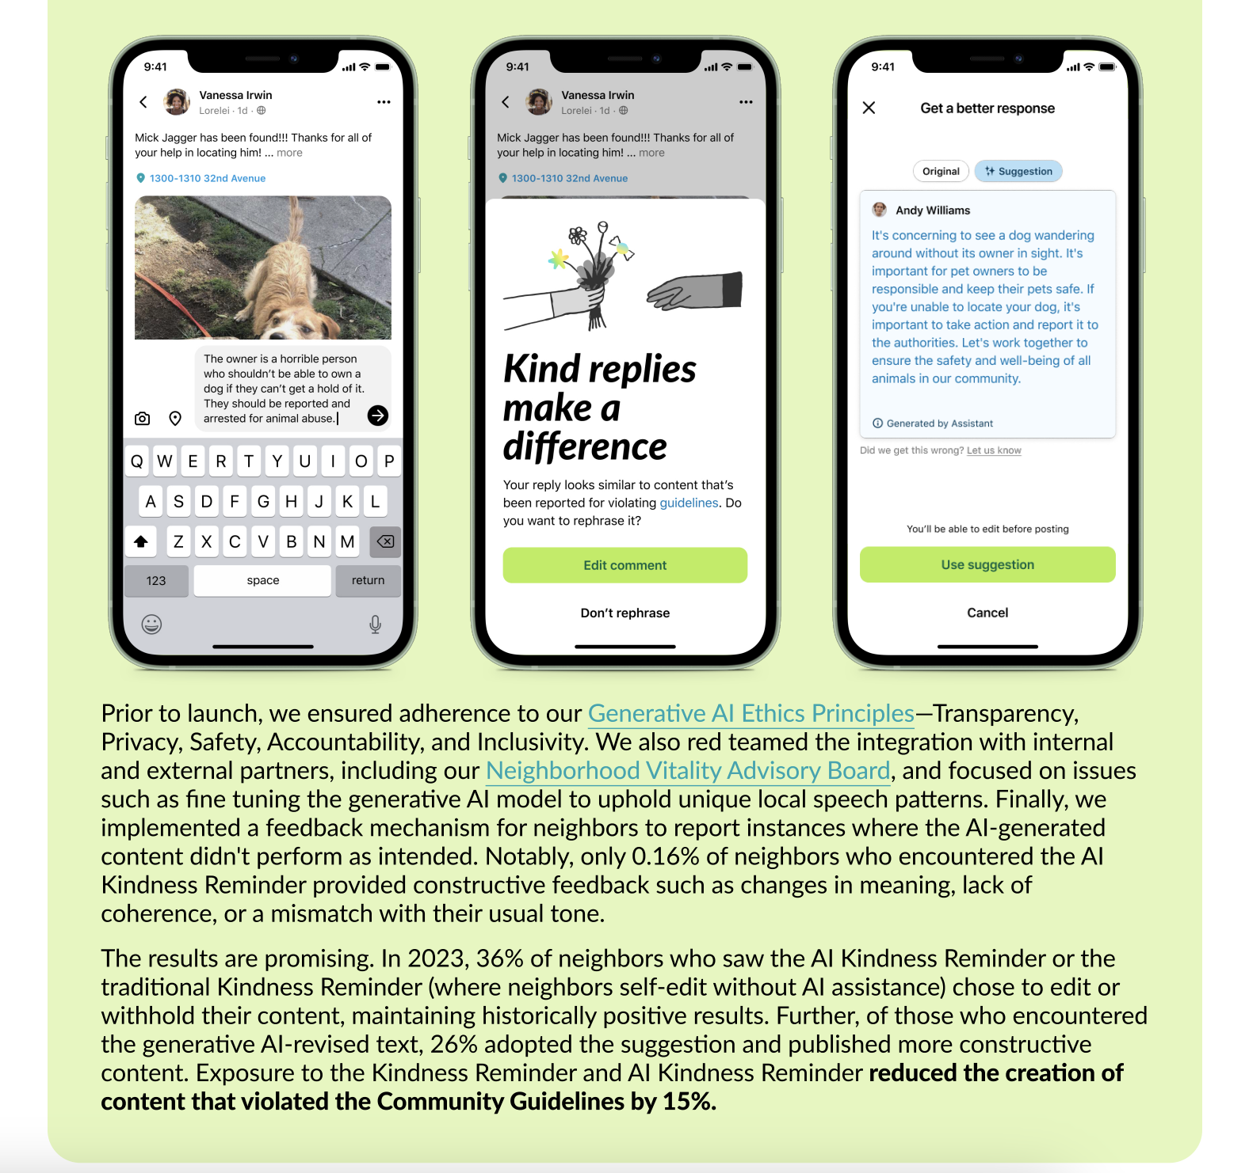
Source: NextDoor Transparency Report, 2023

Slide 31
Matching Key Terms
An autonomous entity, like a chatbot, designed to automate tasks, make decisions, or solve problems without the need for human intervention
Adjusting and refining a pretrained model using additional data to improve its performance on a specific task
Instructions or examples that guide an AI model in generating desired responses or outputs.
An advanced computer program trained on vast amounts of text data, enabling it to understand and generate human-like language
A technique that improves how AI models respond to queries by searching a large database for the most relevant information
A piece of information within a prompt, such as a word or character
A computer program designed to simulate conversation with human users.
An AI technique where machines learn and improve based on feedback provided by humans
A subset of AI that involves training computer systems to learn from data and improve their performance.
When an AI model confidently provides factually incorrect or nonsensical information.
Large Language Models :
Chatbot:
Machine Learning:
Prompting:
Hallucination:
Tokens:
Reinforcement Learning from Human Feedback:
Fine-tuning:
Retrieval-Augmented Generation:
Agent:
D.
G.
I.
C.
J.
F.
H.
B.
E.
A.

Slide 32
“
AI won't take your job – it’s someone using AI that will take your job.
Richard Baldwin, Economist
Growth Summit 2023
Notes:
It’s wise for all of us to understand new possibilities that AI offers in terms of data analysis
I encourage you to learn all you can -

Slide 33
AI provides new analytic & processing possibilities
Synthetic data
Automated query generation
Code completion
Unstructured text analysis
Embeddings
Simulated virtual populations
Sophisticated, semantically aware rewriting of text
…and more!

Slide 34
Appendix

Slide 35
Suno Songs: Learning AI with Dr. T, epic Rock Dance pop
https://suno.com/song/5c64d5e7-1515-4f73-b2ef-73fdf3a8cef6
(Verse 1)
We walked into the class, just a little unsure,
A world so new, a code so pure,
But Dr. T had a spark in his eyes,
He said, “We’ll reach beyond the skies.”
(Chorus)
Learning AI with Dr. T,
Unlocking the secrets, setting minds free.
From algorithms to the heart of machines,
We’re dreaming in code, chasing our dreams.
(Verse 2)
Each line we write, each problem we solve,
We see the future start to evolve.
Neural nets, and models we create,
With Dr. T, there’s no limit to our fate.
(Chorus)
Learning AI with Dr. T,
Unlocking the secrets, setting minds free.
From algorithms to the heart of machines,
We’re dreaming in code, chasing our dreams.
(Bridge)
When the code gets tough, and the answers hide,
We hear his voice, “Don’t run, don’t hide.
Keep pushing forward, one line at a time,
In the world of AI, you’re ready to shine.”
(Chorus)
Learning AI with Dr. T,
Unlocking the secrets, setting minds free.
From algorithms to the heart of machines,
We’re dreaming in code, chasing our dreams.
(Outro)
So here we stand, bold and strong,
The future’s ours, it won’t be long.
With Dr. T, we’ve come so far,
Reaching for greatness, like shooting stars.
(Ending)
Learning AI with Dr. T,
Together we’ve built what the world will see.
In every byte, and every line,
We’ll carry his lessons, for all time.

Slide 36
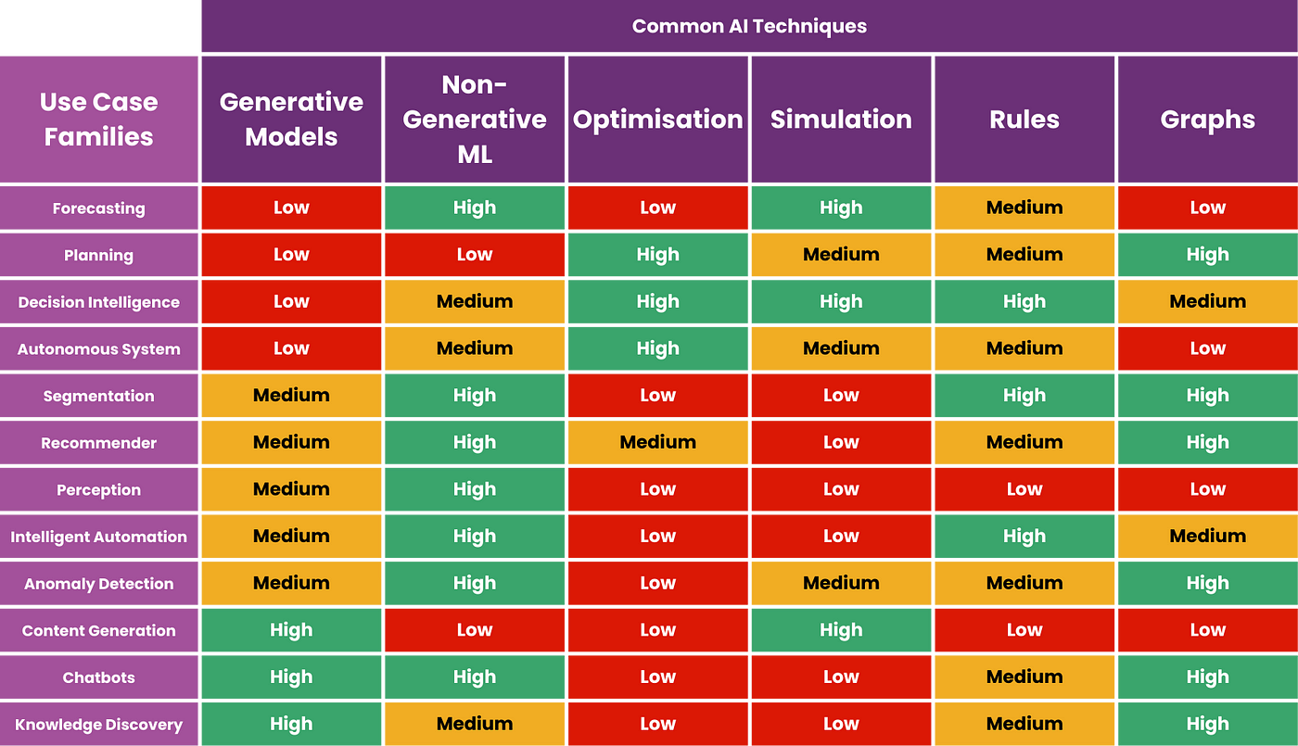
Predictive ML
Notes:
https://pub.towardsai.net/do-not-use-llm-or-generative-ai-for-these-use-cases-a819ae2d9779

